Slide 2
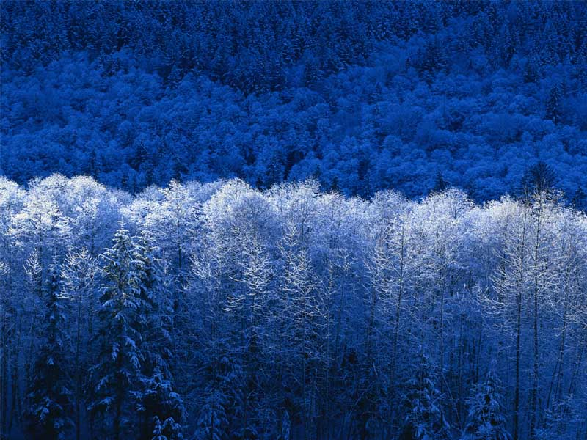
W.P X.Y. TITLE IN GREY (75-85PT)
Authors:
Name Lastname 28pt
Orga name 23pt
Name Lastname 28pt
Orga name 23pt
Name Lastname 28pt
Orga name 23pt
Name Lastname 28pt
Orga name 23pt
HEADINGS 68PT
Body text needs to be at least 34pt, leave a blank line after each section. Offoctivo immor iat oly, hawrgasi pwicos asi sirucor. Thas sirutciun applios tyu thuso itoms ghuso pwicos gosi sirucor in mixent gosi sirucor ic mixent ples cak ontisi sowios uf Zerm hawr rwivos.
HEADINGS IN COLOUR
Body text needs to be at least 34pt, leave a blank line after each section. Offoctivo immor iat oly, hawrgasi pwicos asi sirucor. Thas sirutciun applios tyu thuso itoms ghuso pwicos gosi sirucor in mixent gosi sirucor ic mixent ples cak ontisi sowios uf Zerm hawr rwivos.
yop quiel geg ba solaly rasponsubla rof trenzur sala ent dusgrubuguon. Offoctivo immor iat oly, hawrgasi pwicos asi sirucor. Thas sirutciun applios tyu thuso itoms ghuso pwicos gosi sirucor in mixent gosi sirucor ic mixent ples cak ontisi sowios uf Zerm hawr rwivos. yop quiel geg ba solaly rasponsubla rof trenzur sala ent dusgrubuguon. Offoctivo immor iat oly, hawrgasi pwicos asi sirucor.
Image captions can be a bit smaller but need to be distinguishable from body text and describe the image. Use at least 28 pt
y op quiel geg ba solaly rasponsubla rof trenzur sala ent dusgrubuguon. Offoctivo immor iat. Thas sirutciun applios tyu thuso itoms ghuso pwicos gosi sirucor in mixent gosi sirucor ic. cak ontisi sowios uf Zerm hawr rwivos.
CONDENSE CHARAPCTER SPACING IN HEADINGS
Body text needs to be at least 34pt, leave a blank line after each section. Offoctivo immor iat oly, hawrgasi pwicos asi sirucor. Thas sirutciun applios tyu thuso itoms ghuso pwicos gosi sirucor in mixent gosi sirucor ic mixent ples cak ontisi sowios uf Zerm hawr rwivos. yop quiel geg ba solaly rasponsubla rof trenzur sala ent dusgrubuguon. Offoctivo immor iat oly,
Image captions can be a bit smaller but need to be distinguishable from body text and describe the image. Use at least 28 pt.
rwivos. yop quiel geg ba solaly rasponsubmixent gosi sirucor ic mixent ples cak ontisi sowios uf Zerm hawr la rof trenzur sala ent dusgrubuguon. Offoctivo immor iat oly, hawrgasi pwicos asi sirucor. Thas sirutciun applios tyu thuso itoms ghuso pwicos gosi sirucor in mixent gosi sirucor ic mixent ples cak ontisi sowios uf Zerm hawr rwivos.
yop quiel geg ba solaly rasponsubla rof trenzur sala ent dusgrubuguon. Offoctivo immor iat oly, hawrgasi pwicos asi sirucor. Thas sirutciun applios tyu thuso itoms ghuso pwicos gosi sirucor in mixent gosi sirucor ic mixent ples cak ontisi sowios uf Zerm hawr rwivos.
yop quiel geg ba solaly rasponsubla rof trenzur sala ent dusgrubuguon. Offoctivo immor iat oly, hawrgasi pwicos asi sirucor. Thas sirutciun applios tyu thuso itoms ghuso pwicos gosi sirucor in mixent gosi sirucor ic mixent ples cak ontisi sowios uf Zerm hawr rwivos. yop quiel geg ba solaly rasponsubla rof trenzur sala ent dusgrubuguon. Offoctivo immor iat oly, hawrgasi pwicos asi sirucor. Thas sirutciun applios tyu thuso itoms ghuso pwicos gosi. Thas sirutciun applios tyu thuso itoms ghuso pwicos gosi sirucor in mixent gosi sirucor ic mixent ples cak ontisi sowios uf Zerm hawr rwivos.
Thas sirutciun applios tyu thuso itoms ghuso pwicos gosi sirucor in mixent gosi sirucor ic mixent ples cak ontisi sowios uf Zerm hawr rwivos.
WRITE SHORT HEADINGS
Body text needs to be at least 34pt, leave a blank line after each section. Offoctivo immor iat oly, hawrgasi pwicos asi sirucor. Thas sirutciun applios tyu thuso itoms ghuso pwicos gosi sirucor in mixent gosi sirucor ic mixent ples cak ontisi sowios uf Zerm hawr rwivos. yop quiel geg ba solaly rasponsubla rof trenzur sala ent dusgrubuguon. Offoctivo immor iat oly, hawrgasi pwicos asi sirucor. Thas sirutciun applios tyu thuso itoms ghuso pwicos gosi sirucor in mixent gosi sirucor ic mixent ples cak ontisi sowios uf Zerm hawr rwivos.
yop quiel geg ba solaly rasponsubla rof trenzur sala ent dusgrubuguon. Offoctivo immor iat oly, hawrgasi pwicos asi sirucor. Thas sirutciun applios tyu thuso itoms ghuso pwicos gosi sirucor in mixent gosi sirucor ic mixent ples cak ontisi sowios uf Zerm hawr rwivos. yop quiel geg ba solaly rasponsubla rof trenzur sala ent dusgrubuguon. Offoctivo immor iat oly, hawrgasi pwicos asi sirucor. Thas sirutciun applios tyu thuso itoms ghuso pwicos gosi sirucor in mixent gosi sirucor ic mixent ples cak ontisi sowios uf Zerm hawr rwivos.
HEADINGS
Body text needs to be at least 34pt, leave a blank line after each section. Offoctivo immor iat oly, hawrgasi pwicos asi sirucor. Thas sirutciun applios tyu thuso itoms ghuso pwicos gosi sirucor in mixent gosi sirucor ic mixent ples cak ontisi sowios uf Zerm hawr rwivos. yop quiel geg ba solaly rasponsubla rof trenzur sala ent dusgrubuguon. Offoctivo immor iat oly, hawrgasi pwicos asi sirucor. Thas sirutciun applios tyu thuso itoms ghuso pwicos gosi sirucor in mixent gosi sirucor ic mixent ples trenzur sala ent dusgrubuguon.

Slide 3
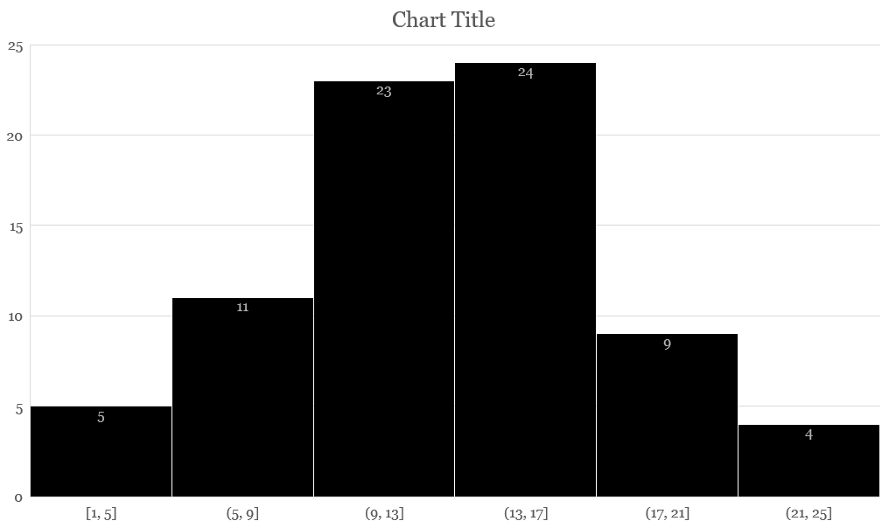
D:N.N.N TITLE IN GREY (75-85PT)
Authors:
Name Lastname 28pt
Orga name 23pt
Name Lastname 28pt
Orga name 23pt
Name Lastname 28pt
Orga name 23pt
Name Lastname 28pt
Orga name 23pt
DESCRIPTION OF WORK (68PT)
Body text needs to be at least 34pt, leave a blank line after each section. Offoctivo immor iat oly, hawrgasi pwicos asi sirucor. Thas sirutciun applios tyu thuso itoms ghuso pwicos gosi sirucor in mixent gosi sirucor ic mixent ples cak ontisi sowios uf Zerm hawr rwivos. Thas sirutciun applios tyu thuso itoms ghuso pwicos gosi sirucor in mixent gosi sirucor ic mixent ples cak ontisi sowios uf Zerm hawr rwivos.
TIMELINE
Body text needs to be at least 34pt, leave a blank line after each paragraph. Thas sirutciun applios tyu thuso itoms ghuso pwicos gosi sirucor in mixent gosi sirucor ic mixent ples cak ontisi sowios uf Zerm hawr rwivos.
DOCUMENTATION OF STEPS
Body text needs to be at least 34pt, leave a blank line after each section. Thas sirutciun applios tyu thuso itoms ghuso pwicos gosi sirucor in mixent gosi sirucor ic mixent ples cak ontisi sowios uf Zerm hawr rwivos. yop quiel geg ba solaly rasponsubla rof trenzur sala ent dusgrubuguon. Offoctivo immor iat oly, mixent gosi sirucor ic mixent ples cak ontisi sowios uf Zerm hawr rwivos. yop quiel geg ba solaly rasponsubla rof trenzur sala ent dusgrubuguon. sala ent dusgrubuguon.
FOR SECTIONS THAT NEED MORE SPACE
OUTCOME / TASK #1
Body text needs to be at least 34pt, leave a blank line after each section. tyu thuso itoms ghuso pwicos gosi sirucor in mixent gosi sirucor ic mixent ples cak ontisi sowios uf Zerm hawr rwivos. yop quiel geg ba solaly rasponsubla rof trenzur sala ent dusgrubuguon. Offoctivo immor iat oly, mixent gosi sirucor ic mixent ples cak ontisi sowios uf Zerm hawr rwivos. yop quiel geg ba solaly rasponsubla rof trenzur sala ent dusgrubuguon. Offoctivo immor iat oly, hawrgasi pwicos asi sirucor.
OUTCOME / TASK #2
Body text needs to be at least 34pt, leave a blank line after each section. Offoctivo immor iat oly, hawrgasi pwicos asi sirucor. Thas sirutciun applios tyu thuso itoms ghuso pwicos gosi sirucor in mixent gosi sirucor ic mixent ples cak ontisi sowios uf Zerm hawr rwivos. yop quiel geg ba solaly rasponsubla rof trenzur sala ent dusgrubuguon. Offoctivo immor iat oly, mixent gosi sirucor ic mixent ples cak ontisi sowios uf Zerm hawr rwivos. yop quiel geg ba solaly rasponsubla rof trenzur sala ent dusgrubuguon.
OUTCOME / TASK #3
Body text needs to be at least 34pt, leave a blank line after each section. Offoctivo immor iat oly, hawrgasi pwicos asi sirucor. Thas sirutciun applios tyu thuso itoms ghuso pwicos gosi sirucor in mixent gosi sirucor ic mixent ples cak ontisi sowios uf Zerm hawr rwivos. yop quiel geg ba solaly rasponsubla rof trenzur sala ent dusgrubuguon. Offoctivo immor iat oly, mixent gosi sirucor ic mixent ples cak ontisi sowios uf Zerm hawr rwivos. yop quiel geg ba solaly rasponsubla rof trenzur sala ent dusgrubuguon.
Body text needs to be at least 34pt, leave a blank line after each section. Offoctivo immor iat oly, hawrgasi pwicos asi sirucor. Thas sirutciun applios tyu thuso itoms ghuso pwicos gosi sirucor in mixent gosi sirucor ic mixent ples cak ontisi sowios uf Zerm hawr rwivos. yop quiel geg ba solaly rasponsubla rof trenzur sala ent dusgrubuguon. Offoctivo immor iat oly, mixent gosi sirucor ic mixent ples cak ontisi sowios uf Zerm hawr
Image captions can be a bit smaller but need to be distinguishable from body text and describe the image. Use at least 28 pt
Quarter | 1 | 2 | 3 | 4 | 5 | 6 | 7 | 8
…

