Slide 1


CSC’s next supercomputer – coming 2026

Slide 2


DL2026 program
User requirements and expectations are constantly evolving
Invest in an ecosystem that is flexible and meets new requirements
Service and functionality in focus
Coherent overall infrastructure for Finnish research
Complementary with LUMI and other platforms
Puhti and Mahti will be replaced by a new supercomputer:
Cloud and Allas services to be invested in and improved as well

Slide 3

Roihu is an Eviden BullSequana XH3000 supercomputer

Slide 4

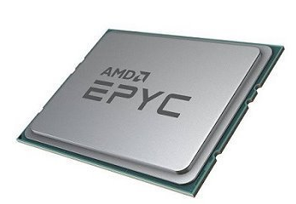
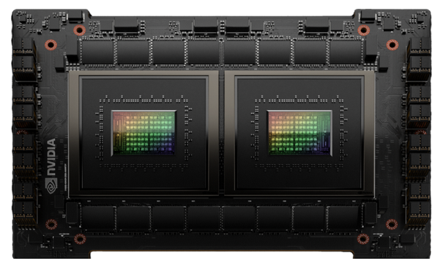
System overview docs.csc.fi/roihu
AGGREGATE HIGH-PERFORMANCE LINPACK 34 PETAFLOPS 33.9 x 10¹⁵ operations per second
486 CPU nodes
2 x 192-core AMD Turin 9965
132 GPU nodes
4 x NVIDIA GH200 superchip
Infiniband NDR interconnect 200 Gbit/s per CPU node 200 Gbit/s per GPU
EVIDEN XH3000 SUPERCOMPUTER 9 RACKS Fully liquid cooled – over 1 MW of power
DDN EXASCALER 6.5 PETABYTES Fully flash-based Lustre storage
Scratch disk 6 PiB 560 GB/s read perf 280 GB/s write perf
Home & ProjAppl disk 0.5 PiB 120 GB/s read perf 100 GB/s write perf

Slide 5
Overview of solution – Roihu compute
Roihu is an Eviden XH3000 system
Next generation of Mahti (XH2000)
CPU partition based on AMD Turin 9965
2 x 192 cores per node
AMD Zen 5 architecture has full AVX-512 support – twice the Flop rate vs. Mahti
GPU partition based on NVIDIA GH200
4 x H100 GPUs & 72-core Grace ARM CPUs per node
Best price/performance solution for HPC & AI
Special resources
4 x high memory (6 TiB) and visualization nodes (NVIDIA L40), each with 2 x 7.68 TB local disks
307.2 TB disaggregate NVMe capacity
Roihu
CPU compute nodes | 486
CPU cores | 186 624
Memory per node | 768–1536 GiB
GPU compute nodes | 132
GPUs | 528
Memory per chip | 120+96 GiB (CPU+GPU)
Scratch storage | 6+ PiB
Home and ProjAppl | 0.5 PiB
Node temp storage | 960 GB
HPL aggregate perf. | 33.9 PFlop/s

Slide 6
Overview of solution – Roihu storage
Fully flash-based Scratch storage for active data
Home and ProjAppl storage system
Node local storage resources
10 times more bandwidth than Puhti Scratch
Much better performance for difficult I/O patterns
6 PiB total capacity
Can be expanded during lifetime of system
ProjData – special disk area on Scratch filesystem for storing and sharing datasets
Application installations and home folders
Separated from Scratch
Ensures responsiveness even under heavy Scratch load
0.5 PiB total capacity
Very fast performance (100+ GB/s)
All nodes have 960 GB local disks
For temporary files, not high-performance I/O
Hugemem and visualization nodes have 15.36 TB high-performance NVMe storage
307.2 TB disaggregated NVMe capacity
Appears as local scratch from within a Slurm job
Notes:
ProjData: sharing and storing data within or between projects. Also for sharing binaries between projects. Access right management done in MyCSC, not manual operations on Roihu.

Slide 7
New ProjData disk area
WORK IN PROGRESS! Please send feedback to katri.tegel@csc.fi
Main characteristics
Use cases
Apply for access via MyCSC
/projdata/project_1234567
No disk cleaning, life-time limited by project life-time
Ability to share read access to other projects
Only available for new ”Dataset Projects”
Computing not possible using these projects
Dataset made available close to compute on fast disk
High-value static data
E.g. database-like set of files used for full project life-time
Sharing applications and binaries with other groups
Description of data, can link to Dataset-as-a-Service (DaaS) and Fairdata services
Catalog of Roihu local datasets made available to users
Overall quota of ProjData will be limited – life-time of projects will be enforced and free space may not be available for new projects

Slide 8
New ProjData disk area
WORK IN PROGRESS! Please send feedback to katri.tegel@csc.fi
Main characteristics
Use cases
Apply for access via MyCSC
System
Located on the "scratch" lustre filesystem
path /projdata/proj_1245
Applicable project type: dataset-project
This disk area is only available for "dataset-projects"
dataset-projects can only have storage-BUs, not CLOUD, CPU or GPU BUs
Slurm association not needed for these projects (no jobs possible)
Dataset
Dataset is close to compute. It should always be a copy, not the primary storage of the dataset
Dataset can be public, or a more controlled one shared between multiple groups.
Access modes:
All users on system have read access to data.
Subset of projects have read access to named project.
Write acccess limited to dataset project that is managing the dataset
Access right management done in MyCSC, no manual operations on Roihu
Dataset project PI can generate invite link
Other projects PI gets link, and can assign read access to their projects
Dataset project PI approves each project before access is opened
Application approved by RJR

Slide 9


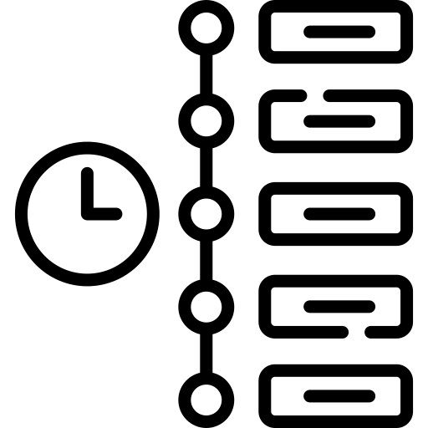


Features and functionality: what will not change
Roihu will have a web interface similar to Puhti & Mahti
Pre-installed module environment
Comprehensive stack of scientific software available
Programming environment will be similar to Mahti (GNU, AOCC, CUDA, OpenMPI, ...)
Slurm batch job scheduler
Queues will have characteristics of both Puhti & Mahti
Apptainer containers and Tykky supported
Improved documentation, base containers and container registry
Tykky will remain available and supported
Disk cleaning policy
Will be enforced from the start, similar to current process on Puhti
CSC will provide improved tools for moving data to/from Allas

Slide 10




Features and functionality: upcoming changes
New hardware and OS (RHEL9)
Intel vs. AMD, GPU nodes will have ARM CPUs (Grace)
Smaller, but much faster storage than Puhti & Mahti combined
Capacity to be expanded during Roihu lifetime
Disaggregated fast storage service
Users can request local disk mounts from centralized storage
Increased security
Short-term certificates required for SSH access
Optional login nodes with per-user container isolation
Support for confidential data computing will be developed
Integration with Sensitive Data services
FirecREST API for accessing Roihu compute and storage
Integrate workflows and web services to HPC

Slide 11
Roihu timetable (tentative)
September 2025
Roihu installation started
May 2026
Roihu general availability (GA)
August 2026
Puhti storage services shut down
March 2026
Roihu pilot phase starts
One month after GA
Puhti computing services shut down
August 2026
Mahti will be decommissioned
Roihu installed in same datacenter as LUMI – will be brought up without disturbing Puhti & Mahti
Aim is to enable users to migrate to Roihu without any break in HPC access

Slide 12
How to prepare for Roihu migration?
Data migration
Application migration
Clean up your data before migration: only move what you really need!
Roihu has less disk space than Puhti & Mahti combined, and stricter criteria for granting extended quotas
Existing quota extensions will not be automatically moved to Roihu
As a general rule, data should be moved directly to Roihu (not via Allas)
Familiarize with data transfer utilities in advance: docs.csc.fi/data/moving
Detailed Roihu migration guide coming later
New hardware, OS, module stack
Prepare to recompile your own software
Check if/how your GPU code can run on the GH200 nodes (ARM)
Containerized Python environments (Tykky) and other Apptainer containers might work as is (except on GPU nodes)
New Slurm partitions – old batch scripts should not be expected to work
CSC will develop documentation and provide templates and support for setting up new scripts and workflows

Slide 13

Changes to Allas and cloud services
New hardware for Allas and Pouta will also be installed as part of DL2026 program
New version of Allas with more storage capacity coming in 2026
”Allas 2” will only support S3 interface – swift not supported
Data will not be automatically migrated – CSC will develop tools and documentation to help with migration in 2026
Pouta
More GPUs, possibility to make available in Rahti
Also storage and CPU resource
ePouta updated end of 2025, cPouta later in 2026

Slide 14
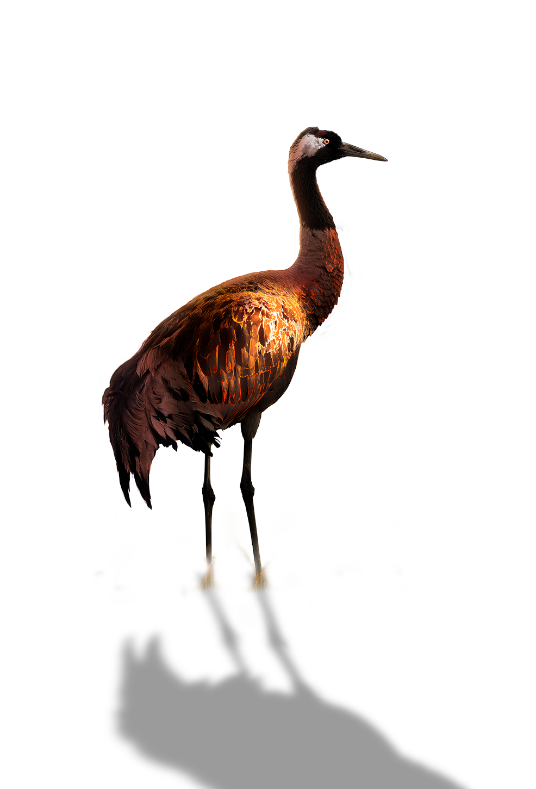


DL2026 outreach project
Project’s aim is to inform about the DL2026 infrastructure renewal and help users to migrate to and use the new systems
How?
Presentation, documentation, self-learning materials, blog posts, ...
docs.csc.fi/roihu
Invite us to tell you more!
We are happy to give a tailored presentation for your lab, department or university about DL2026, Roihu, or CSC services in general
Contact us via:
servicedesk@csc.fi

Slide 15
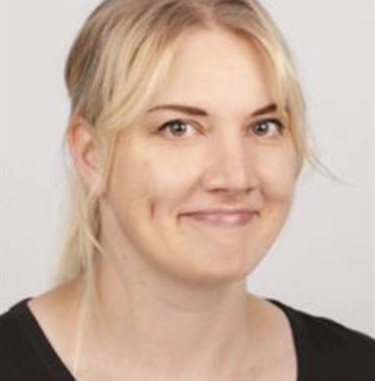
Share your needs and give us feedback!
Katri Tegel, CSC
servicedesk@csc.fi

